Slide 1
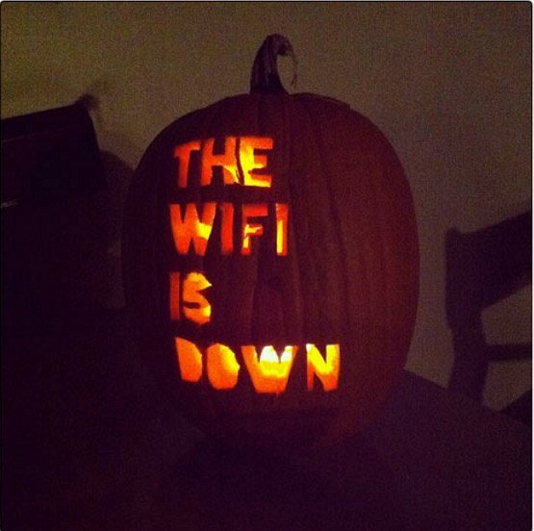
10/31/18 FREAKLY Meeting Update
Goals**, Problems, and Progress
**GHOULS

Slide 2
Goals
Goal for this prototype/this semester:
Wake up system & transmit based on power availability
Power system will communicate to MSP430 when it is allowed to wake up the Bluetooth chip and transmit.
The MSP430 will decide whether to take the power system up on that offer.
If it does, it will power up the Bluetooth module, connect, TX data (not meaningful at this point) to aggregator, and then power down.
Acquire and store sensor data
If we get this early enough, integrate with Goal (a) to TX sensor data
Documentation & planning
Measure system performance & power consumption enough to set semester 2 goals
Notes:
1.58 = 3e-6*86400*365/60

Slide 3
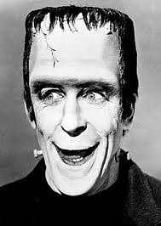
Power of Terror!!!
Goal:
Charge battery using EH IC - DONE
Monitor power availability
How?
Will talk to Erik Welsh
The PMIC can probably do that
What voltages y’all want?
At the moment, I intend on using a regulator (PMIC) to keep a constant 3.3V

Slide 4
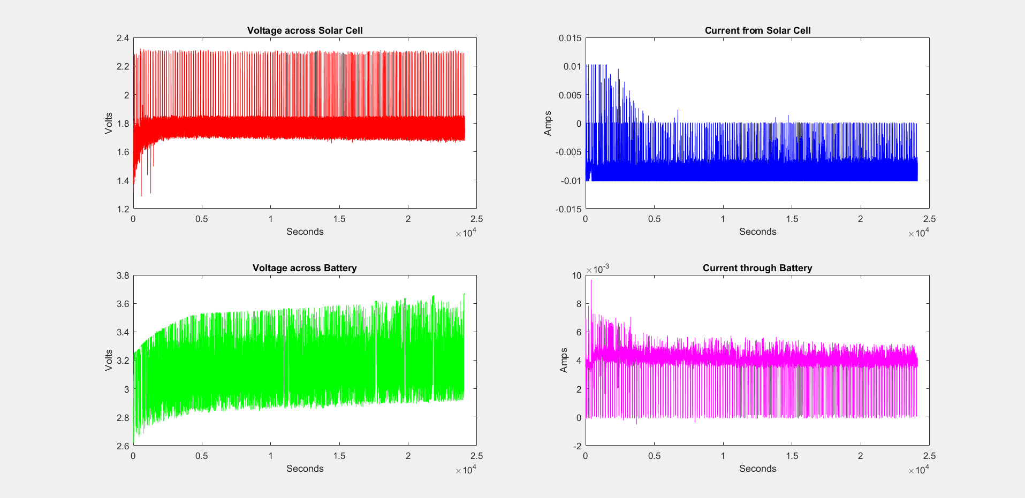

Slide 5
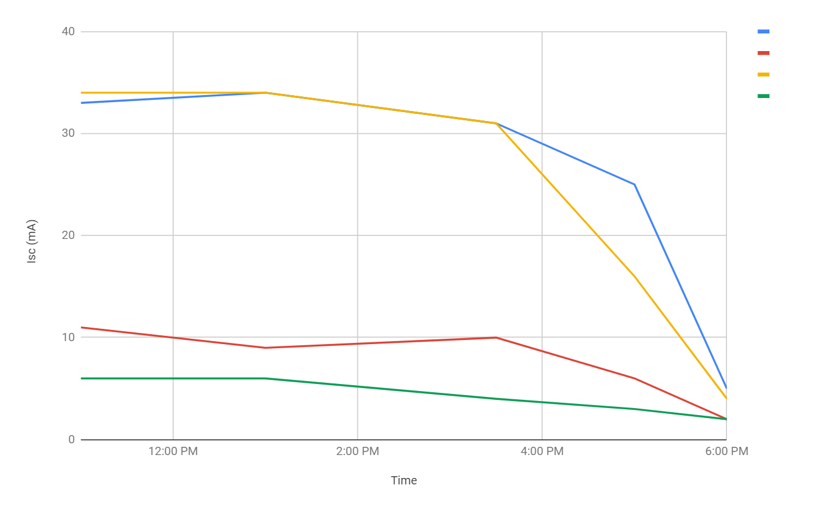
Solar Cell Short Circuit Current
Lamp is comparable to sunlight at 5:00pm
Current at noon ~66% of datasheet value

Slide 6
Communications
Goal
Wake and turn off based on power system
Connect and TX data to phone - DONE
Determine total power consumption per transmission
Peak current draw: 180mV/15ohm = 12 mA*
Avg. current draw while actively transmitting data: 68mV/15ohm = 4.5 mA
Time: ~6ms to transmit 10 data bits @ avg. current draw
Wakeup time/current: Complicated due to flaw below, upper bounds probably: < 4 seconds, ~2mA avg. ish, maybe?
Key Flaw: The Bluefruit module can only operate in peripheral mode:
Cannot initiate connections to other devices.
This won’t work for chaining nodes together
Team Decision: Go ahead with this module anyway for now. Will only transition to something else if it seems reasonable to implement.

Slide 7
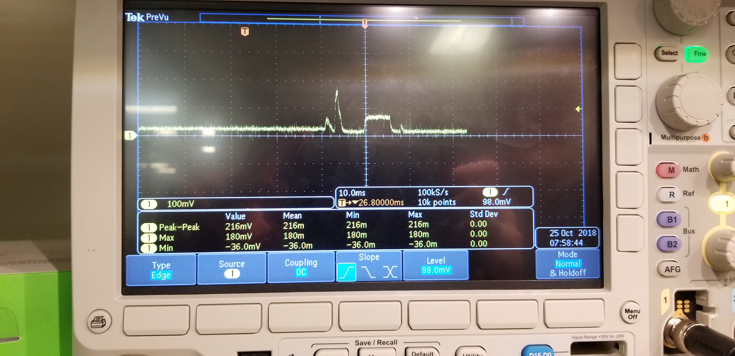

Slide 8
Sensor
Goal:
Be able to acquire data
Store data to FRAM - DONE
I2C is still being problematic
Have demo I2C code and separate code for this sensor → need to compare them to find our issue

